Slide 1
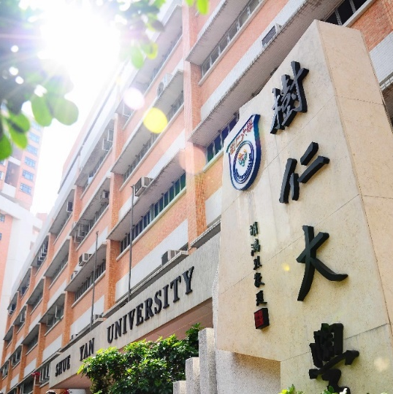
2023-24 年度
一年級同學修科指引
(四年共修125學分畢業)

Slide 2
First Year |  |  | Credits
Compulsory Courses
Language Requirements: |  |  | 14
CHI. | 101-2 | First Year Chinese (including Practical Chinese Writing)
ENG. | 111-2 | English Usage
Departmental Core Requirements: |  |  | 12
SOC. | 100 | Introduction to Sociology
SOC. | 103 | Introduction to Anthropology
SOC. | 108 | Introduction to Statistics
SOC. | 208 | Hong Kong Society and Culture
Departmental Elective Courses* (Choose 3 credits) |  |  | 3
SOC. | 204 | Cultures in the Contemporary World
SOC | 206 | Social Stratification
SOC. | 231 | Social Problems
SOC. | 257 | Art and Society
SOC. | 259 | Race and Ethnicity
SOC. | 260 | Food and Society
General Education Courses |  |  | 6
Total Credits |  |  | 35
*The Departmental Elective Courses offered might be subjected to change

